Slide 1


EMMANUELLA ONOS-ELENBALU
NREGA
ANALYSIS
MENTORNESS DATA ANALYTICS INTERNSHIP

Slide 2

CONTENT
03
PROJECT OVERVIEW
04
DATASET DESCRIPTION
05
DATA PREPARATION AND CLEANING
06
CALCULATED COLUMNS
07
DATA ANALYSIS
14
INSIGHTS
15
RECOMMENDATION

Slide 3


PROJECT
OVERVIEW
The National Rural Employment Guarantee Act (NREGA) is a government scheme aimed at providing rural households with wage employment opportunities.
This project analyses key questions and challenges associated with NREGA.

Slide 4
DATASET DESCRIPTION
The dataset had 30 columns. These include:
State name
District name
Total No. of Job cards issued
Total No. of workers
Total No. of active workers
Total No. of active Job cards
SC workers against active workers
ST workers against active workers
Approved labour budget
Persondays of central liabilities
SC persondays
ST persondays
Women persondays
Average days of employment provided per household
Average wage rate per day per person
Total No. of HHs completed 100 days of way employment
Total household worked
Total Individual worked
Differently abled persons worked
Number of GPs with hNIL exp
Total No. of works takenup
Total number of ongoing works
Total number of completed works
% of NRM Expenditure
% of category B works
% of expenditure on agriculture and agriculture allied works
Total Exp.
Wages
Material and skilled wages
Total Adm expenditure

Slide 5





DATA PREPARATION AND CLEANING
EDA
Formatting
Nulls and Duplicate
Exploratory Data Analysis was carried out on the data to check the number of rows, columns, and if data cleaning would be needed.
The format of the first 2 columns which were uppercase was changed to capitalize each word.
The format for the expenditure and wages columns were also changed to currency
No NULLs were found while duplicates were removed using the District column as key.

Slide 6
CALCULATED COLUMNS
Empolyment per Household(%)
Budget Utilization Rate (%)
Completion Rate (%)
This calculates the employment rate per household in each state.
It is derived by dividing the total household worked by the total job card issued.
This is derived by calculating the percentage of the total expenditure to the approved labour.
This is derived by calculating the percentage of the number of completed works to the number of works takenup.

Slide 7
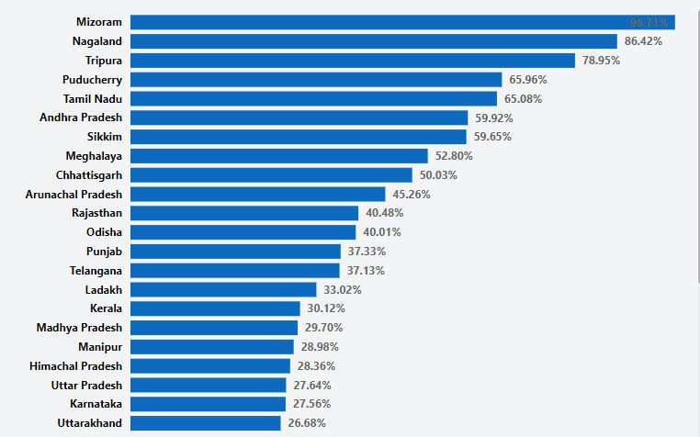
Effectiveness of NREGA: Employment rate per household of States

Slide 8
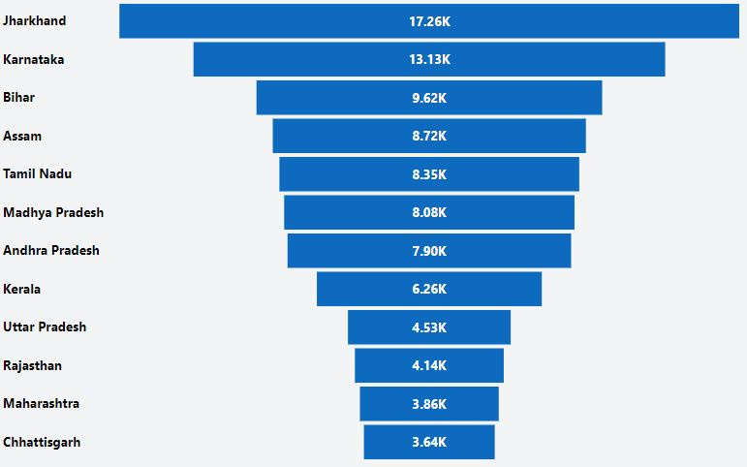
Regional Disparities: States with highest completed works

Slide 9
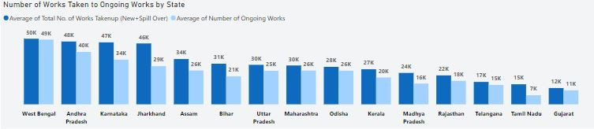
Regional Disparities: States with the Highest Works Takenup and Ongoing works

Slide 10
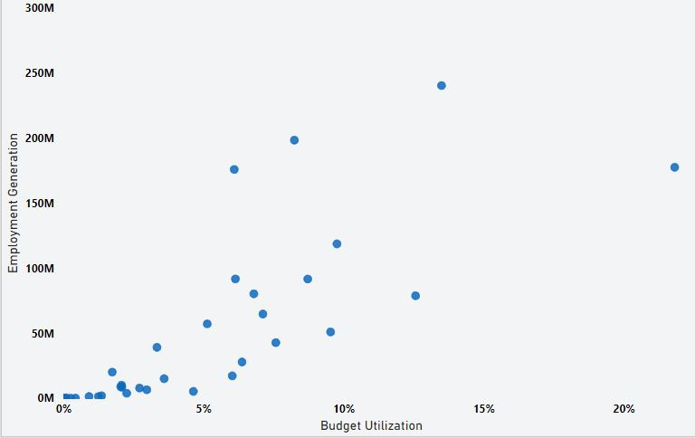
Correlation between Budget Utilization and Employment Generation (personday of central liability

Slide 11
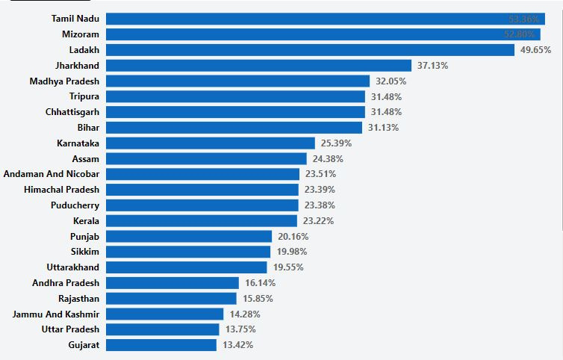
Factors Contributing to the Success of NREGA: Average Completion rate per state

Slide 12
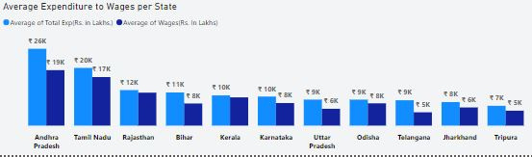
Factors Contributing to the Success of NREGA: Expenditure to Wages per state

Slide 13
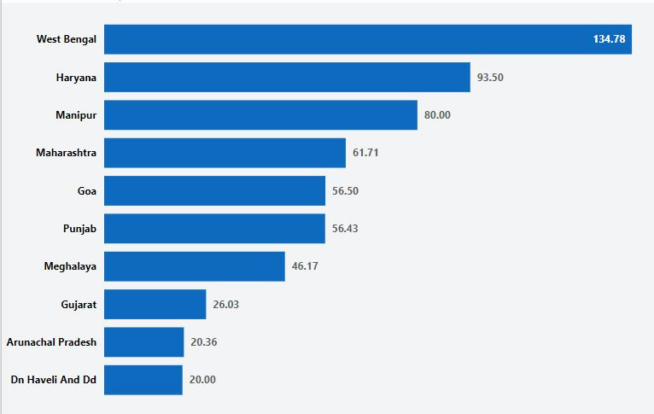
RoadBlocks: States with Gram Panchayats with zero expenditure

Slide 14
DATA-DRIVEN INSIGHTS
16 out of the 30 states studied had an employment rate above 30%, while 9 states had an employment rate above 50%.
Mizoram, the state with the highest employment rate also has the highest completion rate.
West Bengal, the state with the highest number of work takenup and ongoing works is not part of the top 11 states by completed works.
This suggests regional disparities as it is also the top state with zero expenditure for Gram Panchayats.

Slide 15
Keen attention should be paid to states with suspected regional disparities. The underlying cause of this roadblock should be examined.
Since states with higher employment rates tend to have high completion rates, more employment opportunities should be given to states.
Further study should be carried out on how inclusion and diversity among workers aid the completion rate.
RECOMMENDATION

